Slide 1
PGP-DSBA PROJECT REPORT MRA – Main Project PART 1
BY
ISHAAN SHAKTI JAYARAMAN
PGPDSBA.O.JULY24.A

Slide 2
AGENDA
PROBLEM STATEMENT
DATA CONTENTS
DATA DESCRIPTION
STATISTICAL SUMMARY
EXPLORATORY DATA ANALYSIS
UNIVARIATE ANALYSIS
BIVARIATE ANALYSIS
MULTIVARIATE ANALYSIS
CUSTOMER SEGMENTATION & RFM ANALYSIS
RFM ANALYSIS
KNIME WORKFLOW
FINAL OUTPUT
INFERENCES FROM RFM ANALYSIS
TOP 5 BEST CUSTOMERS
TOP 5 CUSTOMERS ON THE VERGE OF CHURNING
TOP 5 LOST CUSTOMERS
TOP 5 LOYAL CUSTOMERS

Slide 3
Problem Statement
An automobile parts manufacturer, experiencing growth over three years, lacks the capability to analyze transaction data for actionable insights. The company aims to uncover patterns in customer purchasing behavior, segment its customers effectively, and optimize marketing strategies. By leveraging data science, the company seeks to implement personalized marketing approaches to improve customer satisfaction, boost sales, and enhance retention. The task is to analyze the data, derive insights, and provide recommendations for informed decision-making.

Slide 4
Data Contents
The dataset (Sales_Data_1.xlsx) contains information pertaining to sales data of various customers for the automobile parts manufacturing company.
There are 2747 observations in the dataset
There are 20 columns of which 7 are numerical variables, 12 are categorical variables and 1 is a date/time variable.
There are no null values in the dataset.
There are no duplicate entries in the dataset.

Slide 5
Data Description
ORDERNUMBER: Unique identifier for each order.
QUANTITYORDERED: Number of items ordered in a specific transaction.
PRICEEACH: Price per unit of the product in the order.
ORDERLINENUMBER: Sequence number of the product in the order.
SALES: Total sales value for the order.
ORDERDATE: Date when the order was placed.
DAYS_SINCE_LASTORDER: Number of days since the customer's previous order.
STATUS: Current status of the order (e.g., Shipped, Disputed).
PRODUCTLINE: Product category to which the item belongs (e.g., Motorcycles, Classic Cars).
MSRP: Manufacturer’s Suggested Retail Price for the product.
PRODUCTCODE: Unique identifier for the product.
CUSTOMERNAME: Name of the customer placing the order.
PHONE: Customer's contact phone number.
ADDRESSLINE1: Customer's primary address.
CITY: City of the customer's address.
POSTALCODE: Postal code of the customer's address.
COUNTRY: Country of the customer's address.
CONTACTLASTNAME: Last name of the customer’s contact person.
CONTACTFIRSTNAME: First name of the customer’s contact person.
DEALSIZE: Size category of the transaction (e.g., Small, Medium, Large).

Slide 6
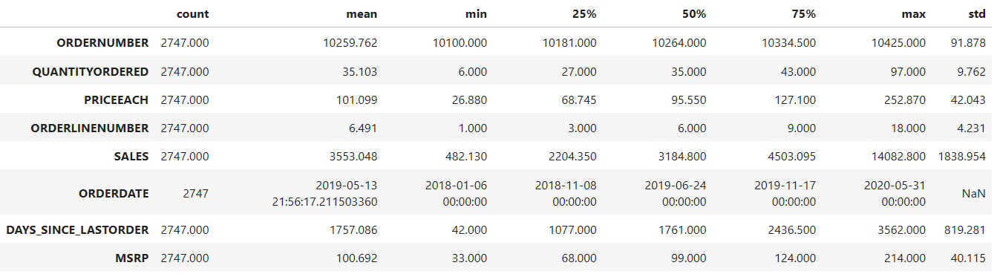
Statistical Summary
All customers ordered an average amount of 35 items with the highest amount being 97 items.
The average price per unit of ordered items is $101.
On average, the days since last order is 1757 days per customers with lowest being 42 days and the highest is 3562 days
Average MSRP of the product is $100.69.

Slide 7
EXPLORAToRY DATA ANALYSIS
Univariate analysis Bivariate Analysis Multivariate Analysis

Slide 8
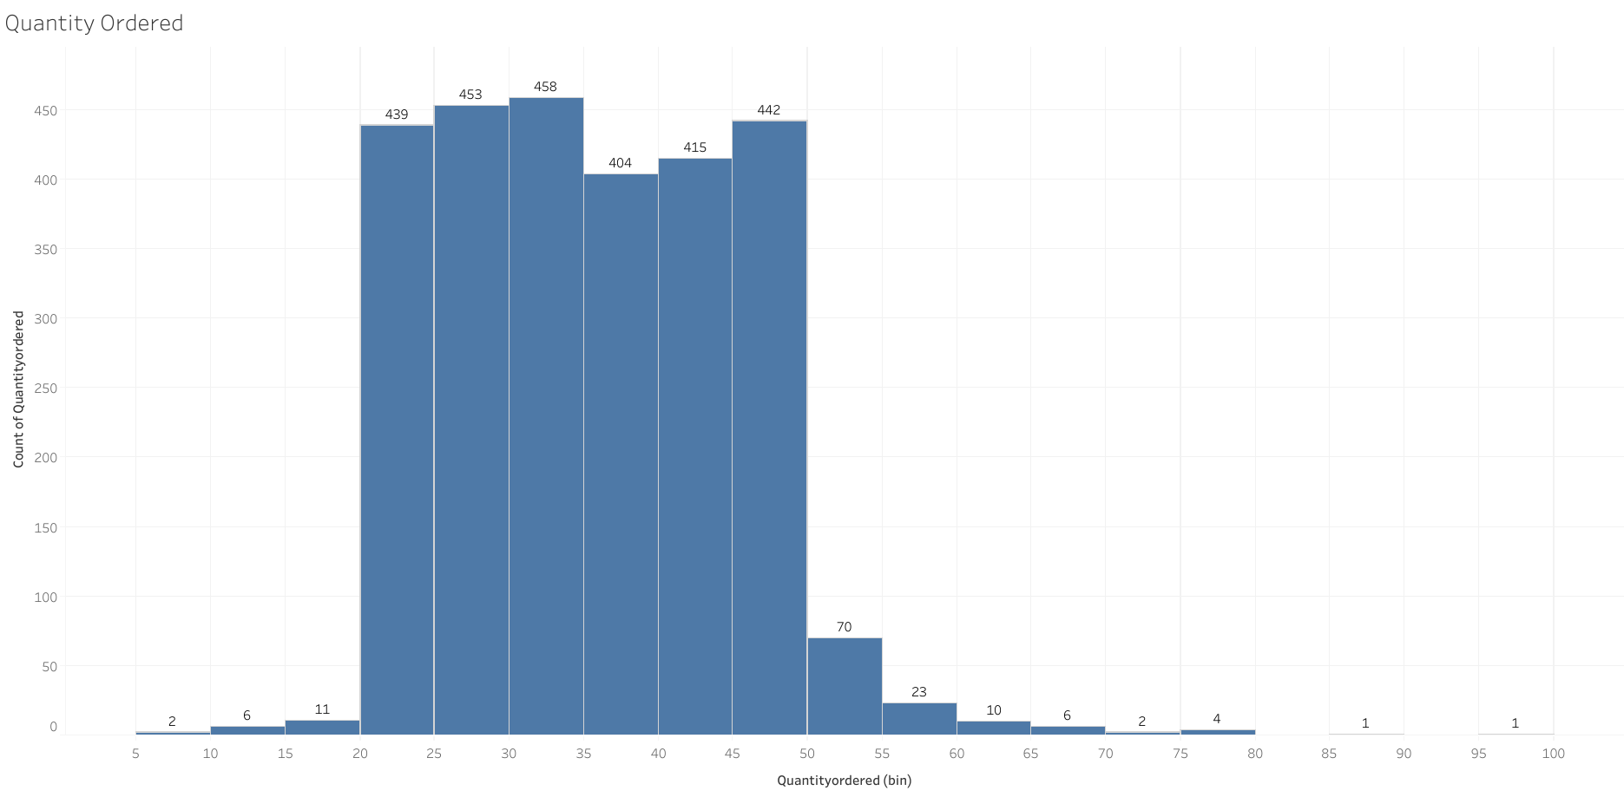
Quantity Ordered
Majority of customers order products ranging from a quantity of 21-50 in a single order.

Slide 9
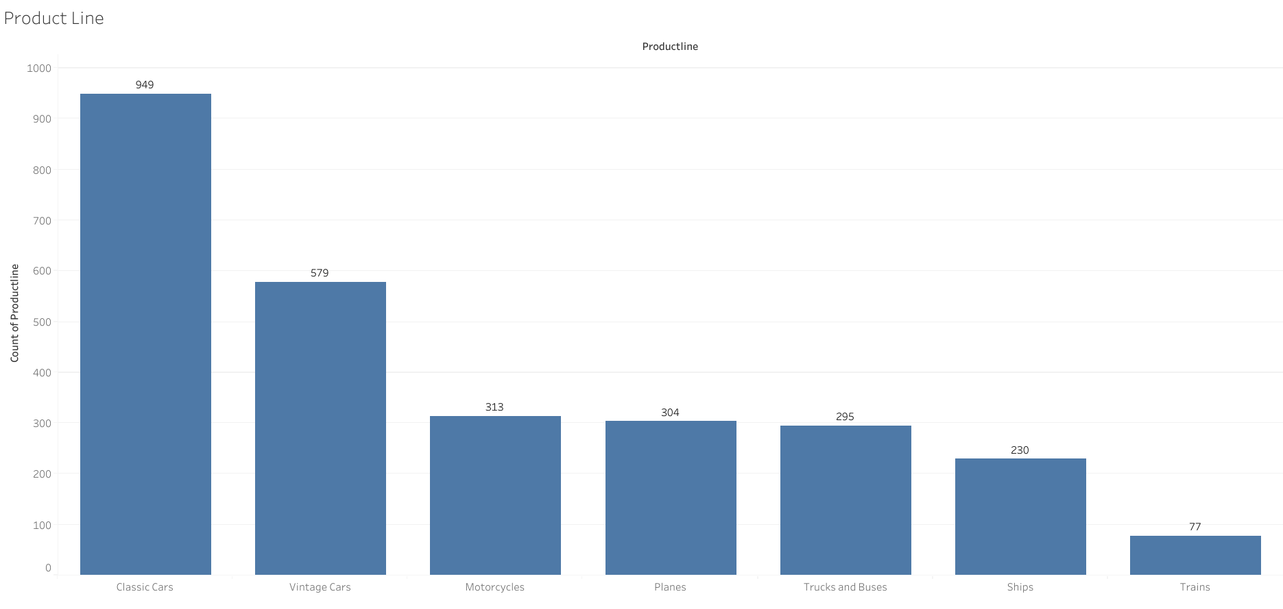
Product Line
Parts for Classic cars are the most popular product line followed by Vintage cars.
Parts for Trains are the least purchased product line.

Slide 10
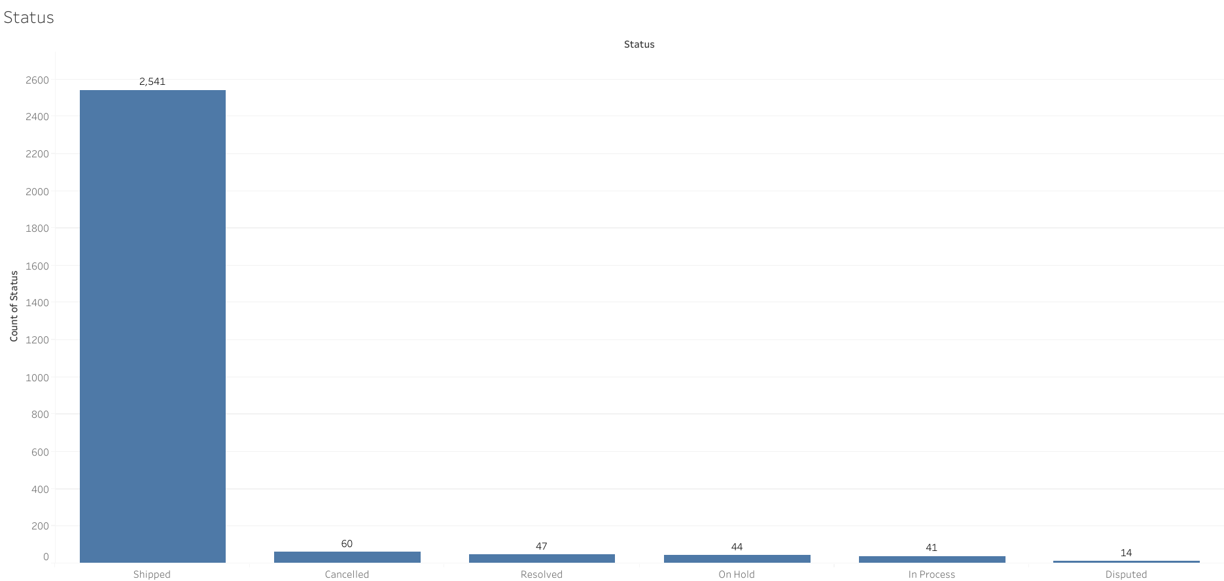
Status
Around 2500 orders have been shipped by company.
14 orders are currently in dispute.
Only 60 orders have been cancelled.

Slide 11
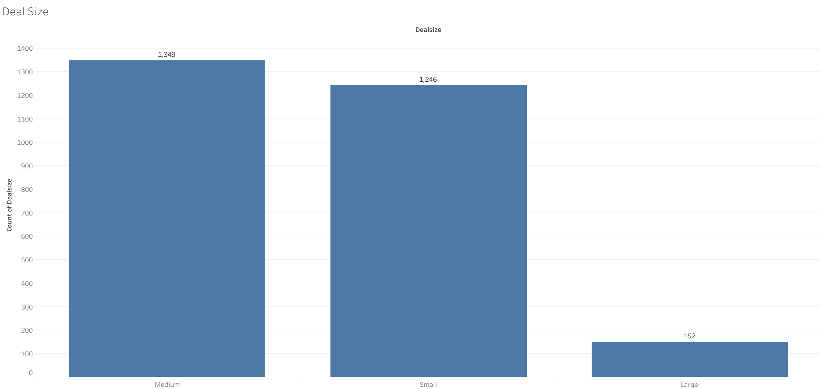
Deal Size
Majority of orders are Medium category size of order as well as small category.
A minority of orders are large category size.

Slide 12
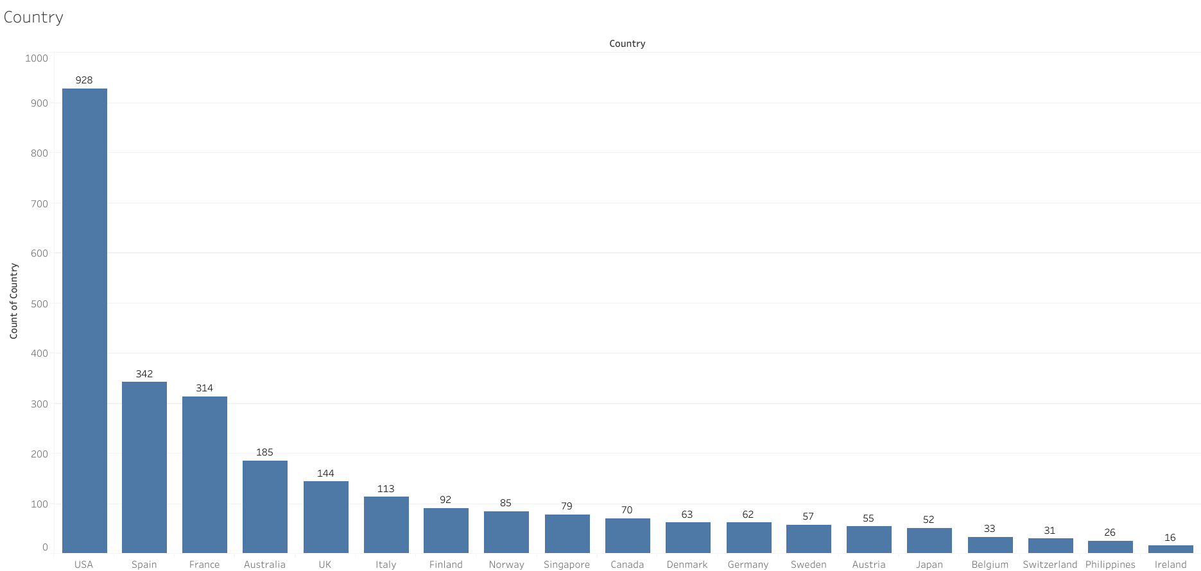
Country
USA has the greatest number of counts of order at 928.
Spain, France and Australia are the next highest countries

Slide 13
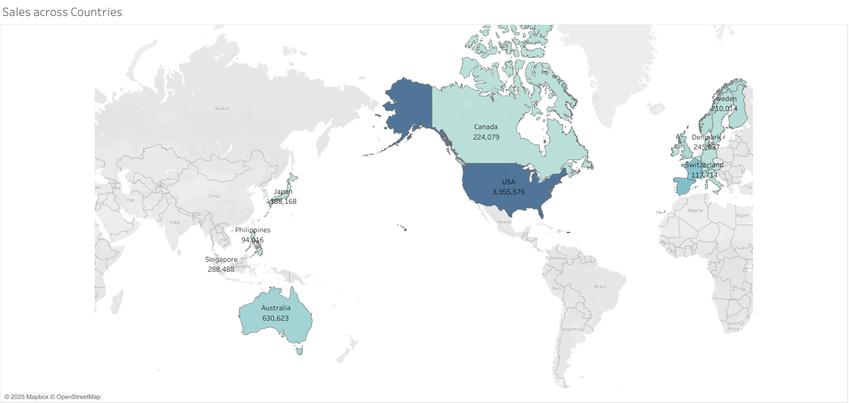
Sales across countries
USA has highest sales at around $3million.
France and Spain have the next highest amount of sales of around $1 million.

Slide 14
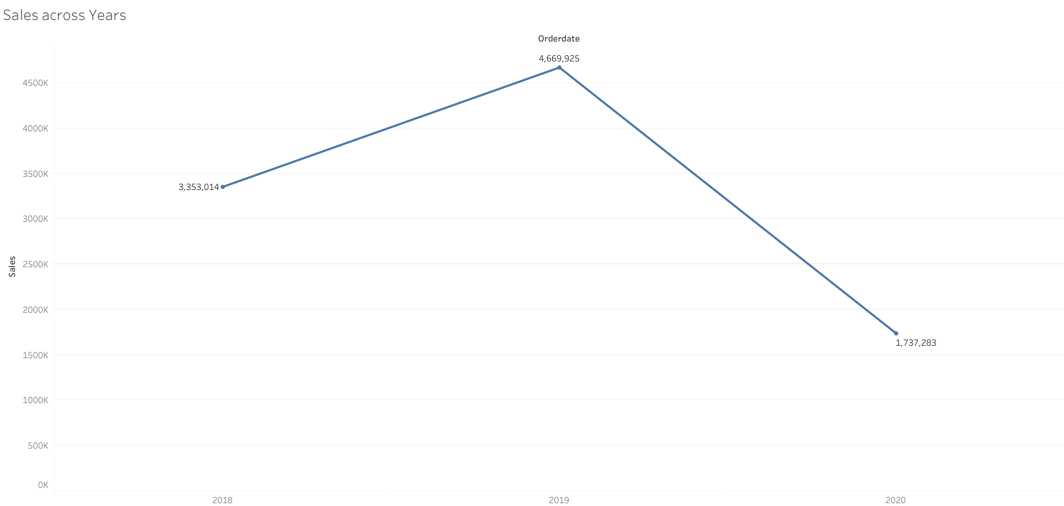
Sales Across Years
2019 sales have increased when compared to 2018.
2020 sales show decline however it is due to data until only Q2.

Slide 15
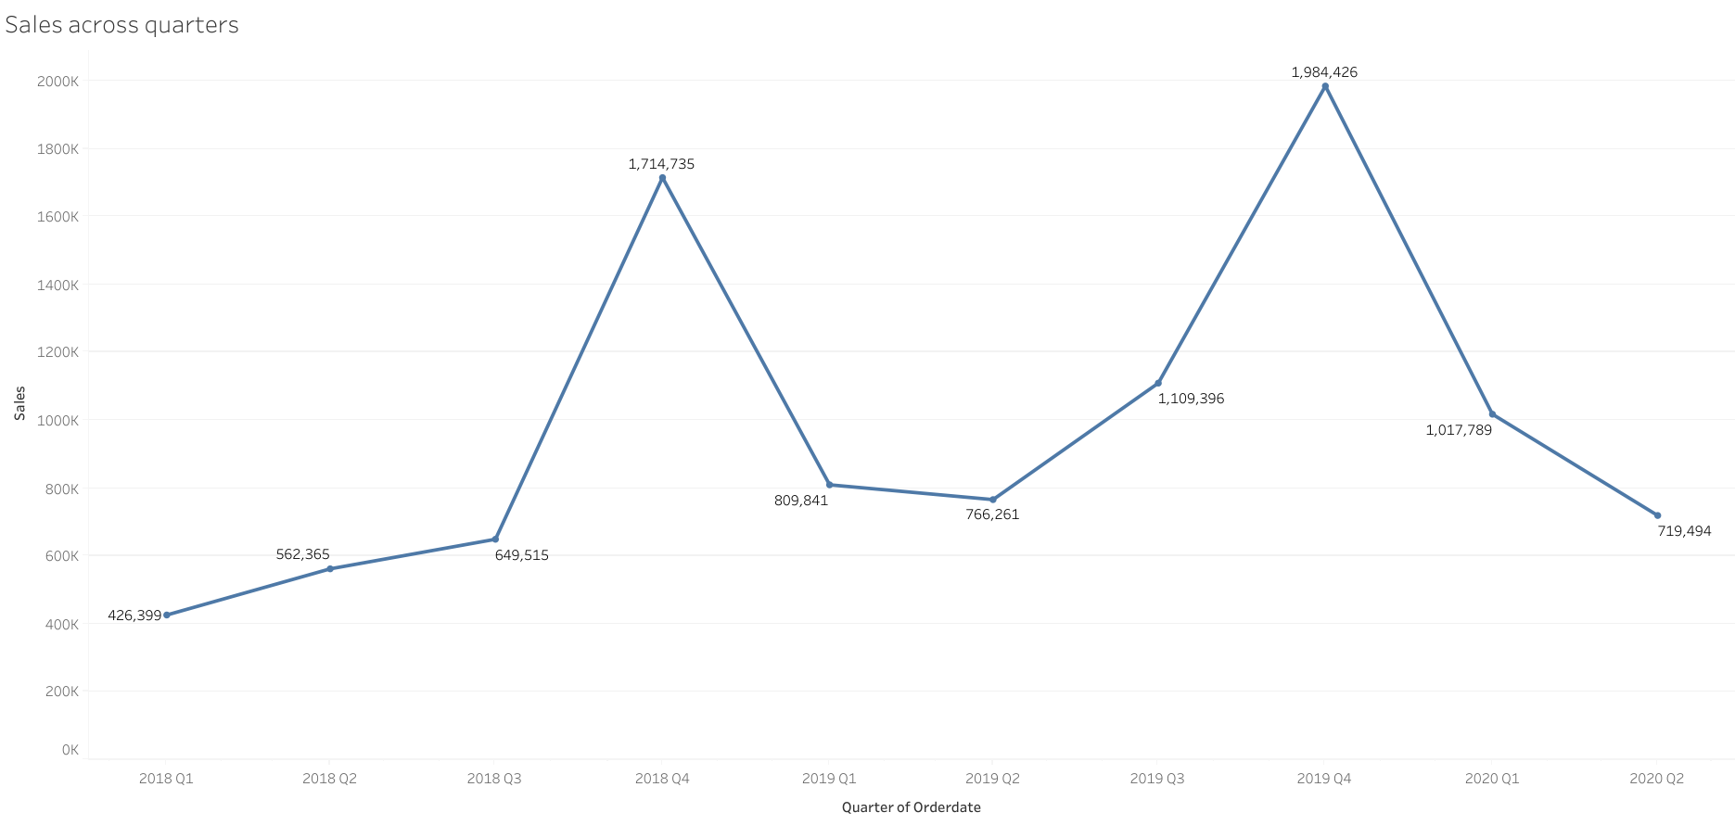
Sales across yearly quarters
There is an increase of sales around Q4 every year indicating seasonality.
There is a slight decline in sales in 2020 Q2 compared to 2019 Q2.

Slide 16
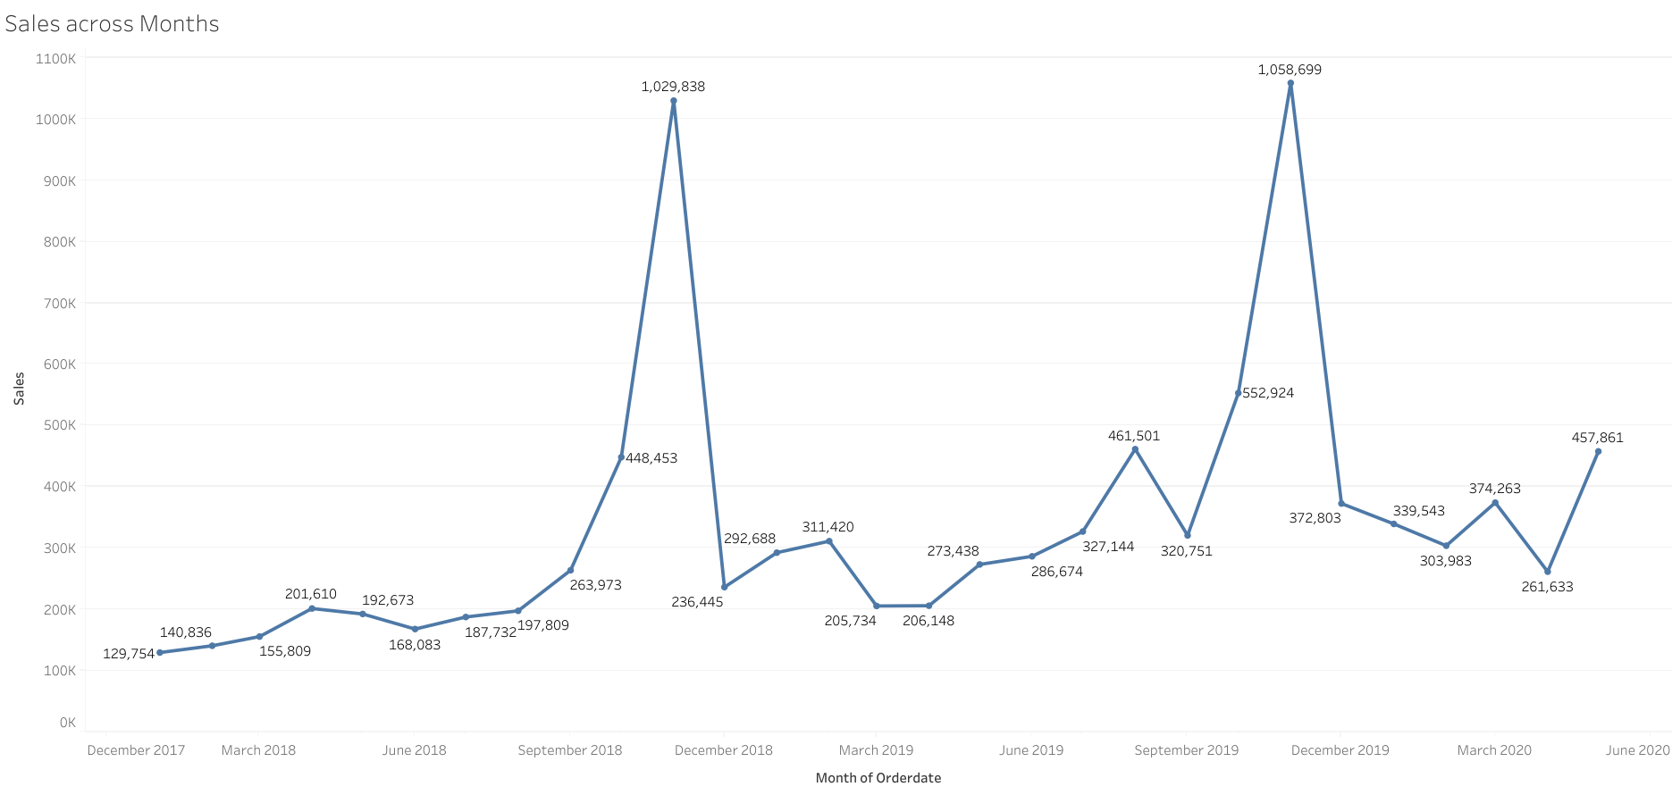
Sales across months
There is an overall increasing trend of sales over the months.

Slide 17
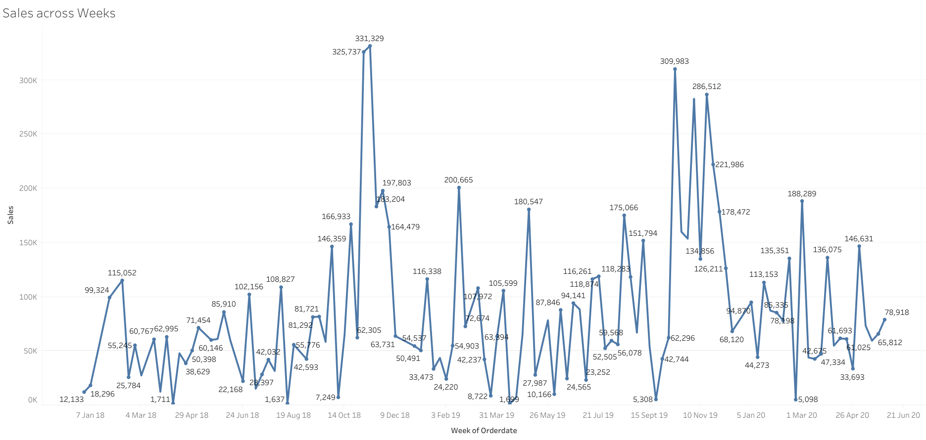
Sales across Weeks
There is an overall increasing trend of sales over the weeks.

Slide 18
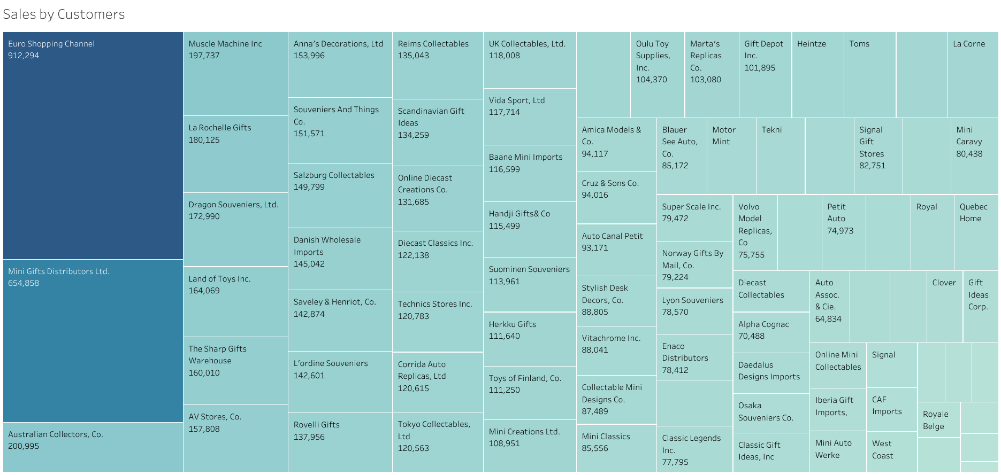
Sales by customers
Euro Shipping Channel is the top customer by sales, followed by Mini Gifts Distribution Ltd.
Australian Collectors, Muscle Machine Inc and La Rochelle Gifts are the next best customers.

Slide 19
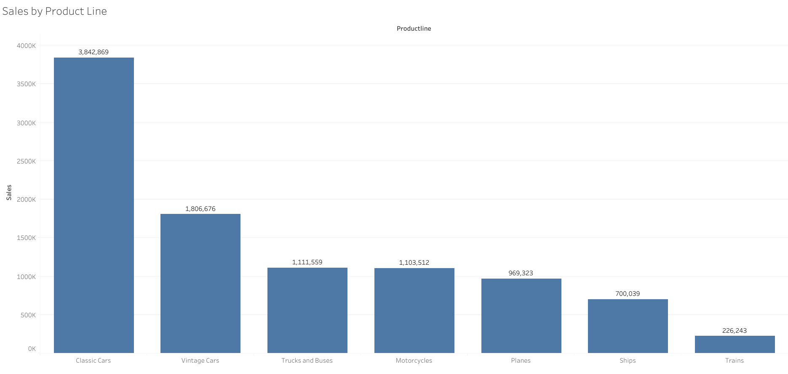
Sales by product line
Euro Shipping Channel is the top customer by sales, followed by Mini Gifts Distribution Ltd.
Australian Collectors, Muscle Machine Inc and La Rochelle Gifts are the next best customers.

Slide 20
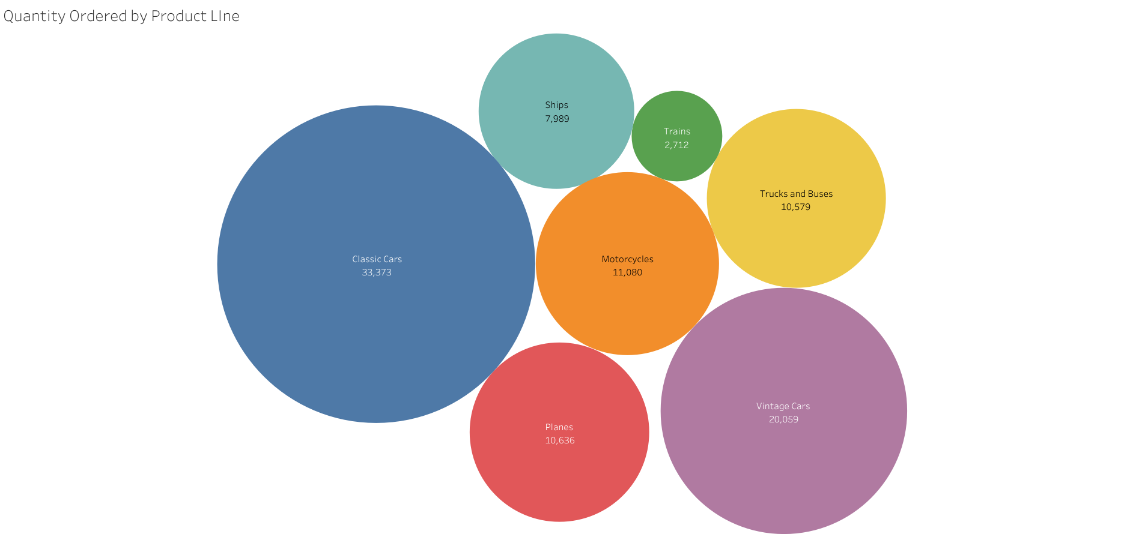
Quantity ordered by product line
Classic Cars and Vintage cars have the highest quantity ordered.
Trains are the least ordered quantity of products.
There are moderate number of quantities ordered for Planes, Motorcycles and Trucks/Buses products.

Slide 21
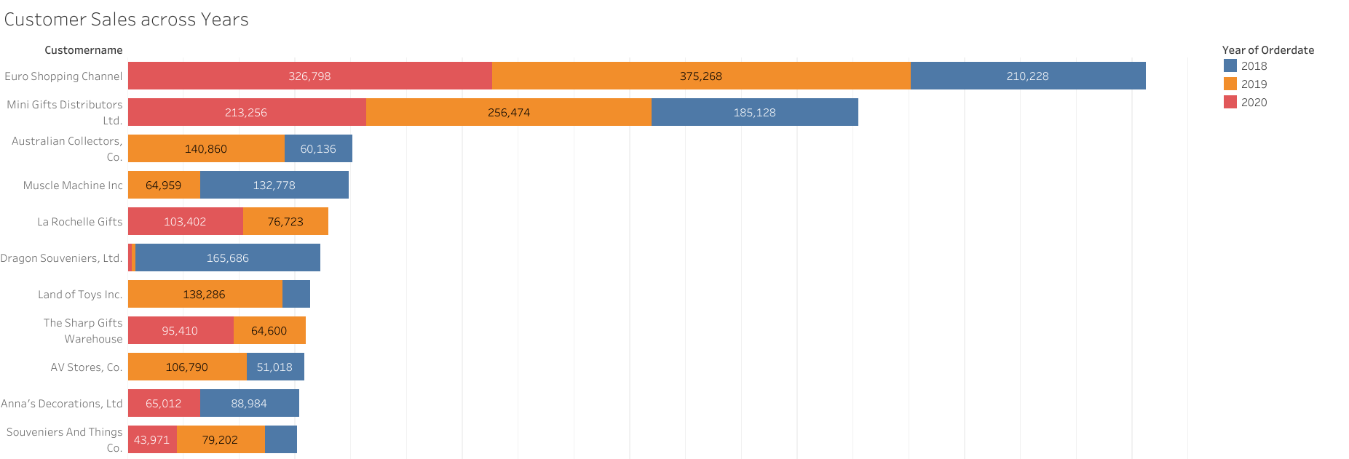
Customer sales across years
Euro Shopping Channel and Mini Gifts Distributors Ltd. have remained high values customers throughout 3 years.
Australian Collectors and Muscle machine Inc have not made any orders in 2020.
Dragon Souveniers Ltd have drastically reduced their orders compared to 2018.

Slide 22
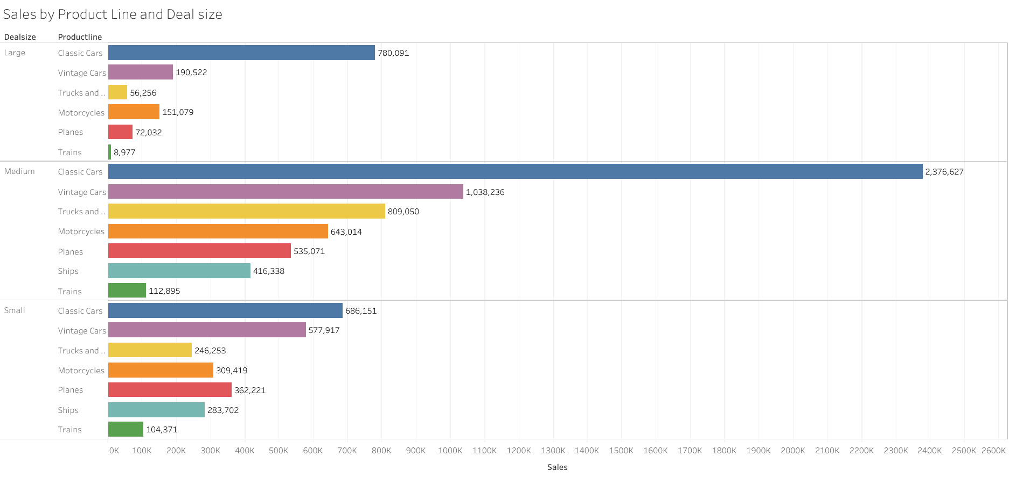
Sales by product line & deal size
Classic Cars and Vintage cars have the highest sales on all deal sizes.
Trucks/buses, Motorcycles, Planes have a moderate number of sales.
Trains have the lowest sales on all deal sizes.

Slide 23
Customer Segmentation & RFM Analysis

Slide 24
RFM Analysis
RFM analysis is a marketing strategy used to evaluate customer value based on three key factors Recency, Frequency, and Monetary value.
Recency: How recently a customer made a purchase.
Frequency: How often a customer makes purchases.
Monetary value: How much a customer spends.
By analyzing these dimensions, businesses can segment customers, target marketing efforts effectively, and improve customer retention strategies.

Slide 25
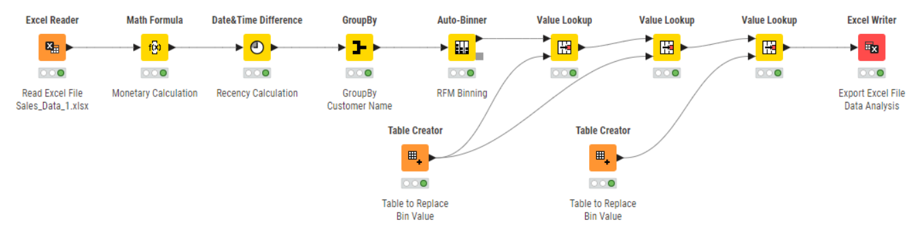
KNIME WORKFLOW
To create a workflow for RFM Analysis, KNIME Analytics Platform is used to import the excel file and through binning divide the customers into 4 segments high, medium, low and very low for each factor of the RFM metric.
*Value Lookup Node is used to replace values as Cell Replacer node has been deprecated

Slide 26
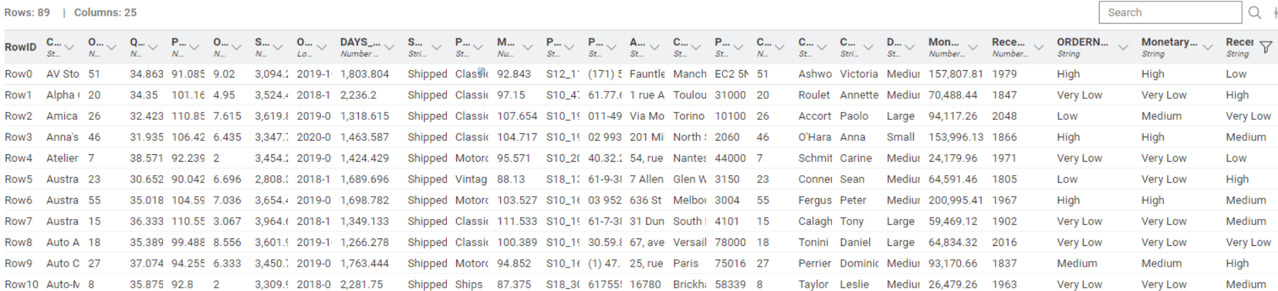
Final Output
Each customer has been identified a value of either High, Medium, Low and Very Low for the 3 factors of Recency, Frequency and Monetary. Customers can be targeted based on these factors to improve retention by promoting marketing strategies.

Slide 27
INFERENCES FROM RFM Analysis

Slide 28
Top 5 Best customers
The Top 5 Best Customers are those who have the highest RFM scores, they are
Euro Shopping Channel
Mini Gifts Distributors Ltd.
La Rochelle Gifts
The Sharp Gifts Warehouse
Souveniers and Things Co.

Slide 29
Top 5 customers on the verge of churning
The Top 5 Customers on the verge of churning are those who have low recency score but high-medium frequency and monetary scores, they are
Heintze Collectables
Corrida Auto Replicas, Ltd
Online Diecast Creations Co.
Baane Mini Imports
Rovelli Gifts

Slide 30
Top 5 lost customers
The Top 5 Lost Customers are those who have very low RFM scores, they are
Daedalus Designs Imports
Osaka Souveniers Co.
Auto Assoc. & Cie.
Clover Collections, Co.
Online Mini Collectables

Slide 31
Top 5 loyal customers
The Top 5 Loyal Customers are those who have high Recency and Frequency Scores, they are
The Sharp Gifts Warehouse
Danish Wholesale Imports
Salzburg Collectables
Euro Shopping Channel
Mini Gifts Distributors Ltd.

Slide 32
END OF PART 1
PGP-DSBA MRA Main Project
BY
ISHAAN SHAKTI JAYARAMAN
PGPDSBA.O.JULY24.A

